Slide 1

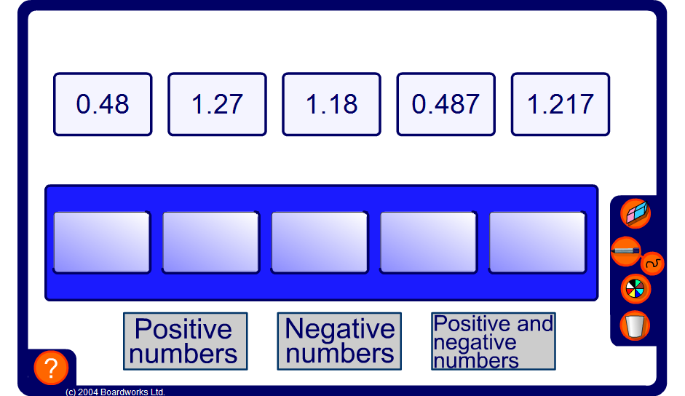


Ordering decimals
Notes:
Drag and drop each card underneath in order according to suggestions from pupils. Compare units, tenths, hundredths and thousandths in turn.
Ensure that the concept of working from the left until you find the highest digit is understood.

